Slide 1
Group Decisions
Jerry Quoe, Jimmy Lee, & Ronald Monte

Slide 2
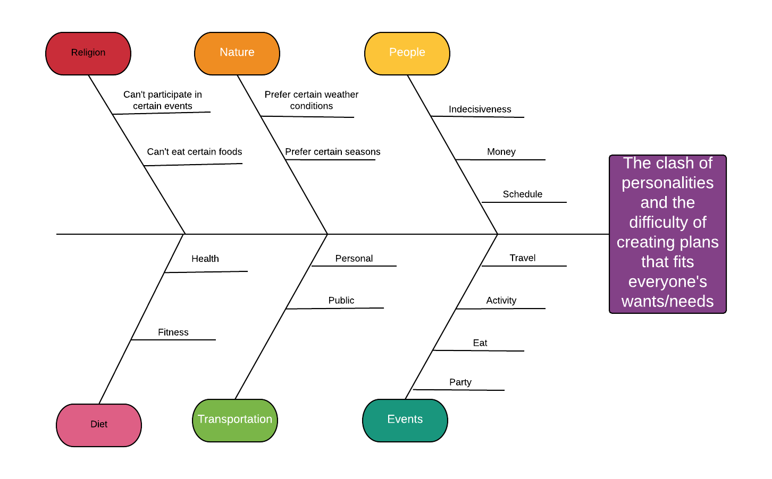
Ishikawa diagram
Notes:
Our defect is dealing with peoples personalities when creating plans or making decisions. People: indecisiveness – people cannot decide what they want to do. Money – not everyone can afford everything and some people want to be at a more expensive place. Schedule – people are busy and sometimes they have other obligations they must attend to. Events: different people want to so different things such as travel, eat, party. Nature – some people prefer certain conditions or temperatures to do certain events. Transportation – some people enjoy taking public transportation but others are unwilling to take public transit. Religion: Depending on a person’s beliefs they are unable to do certain things or eat certain things and vice versa they have to do other things such as pray/ go to church. Diet – certain people have diet obligations such as health and fitness.

Slide 3
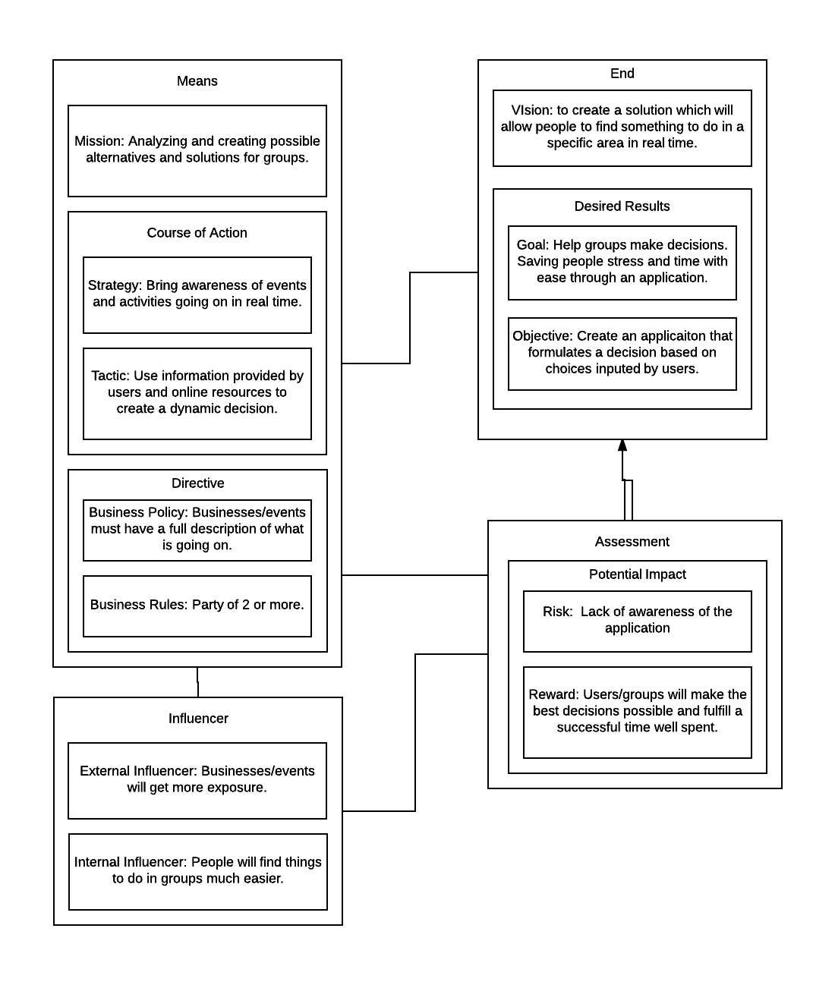
BMM
Notes:
Our mission is to help groups of people deal with making group decisions. By bringing awareness about different possibilities and using information gathered through user input and other repositories our application will be able to make an intelligent decision.

Slide 4
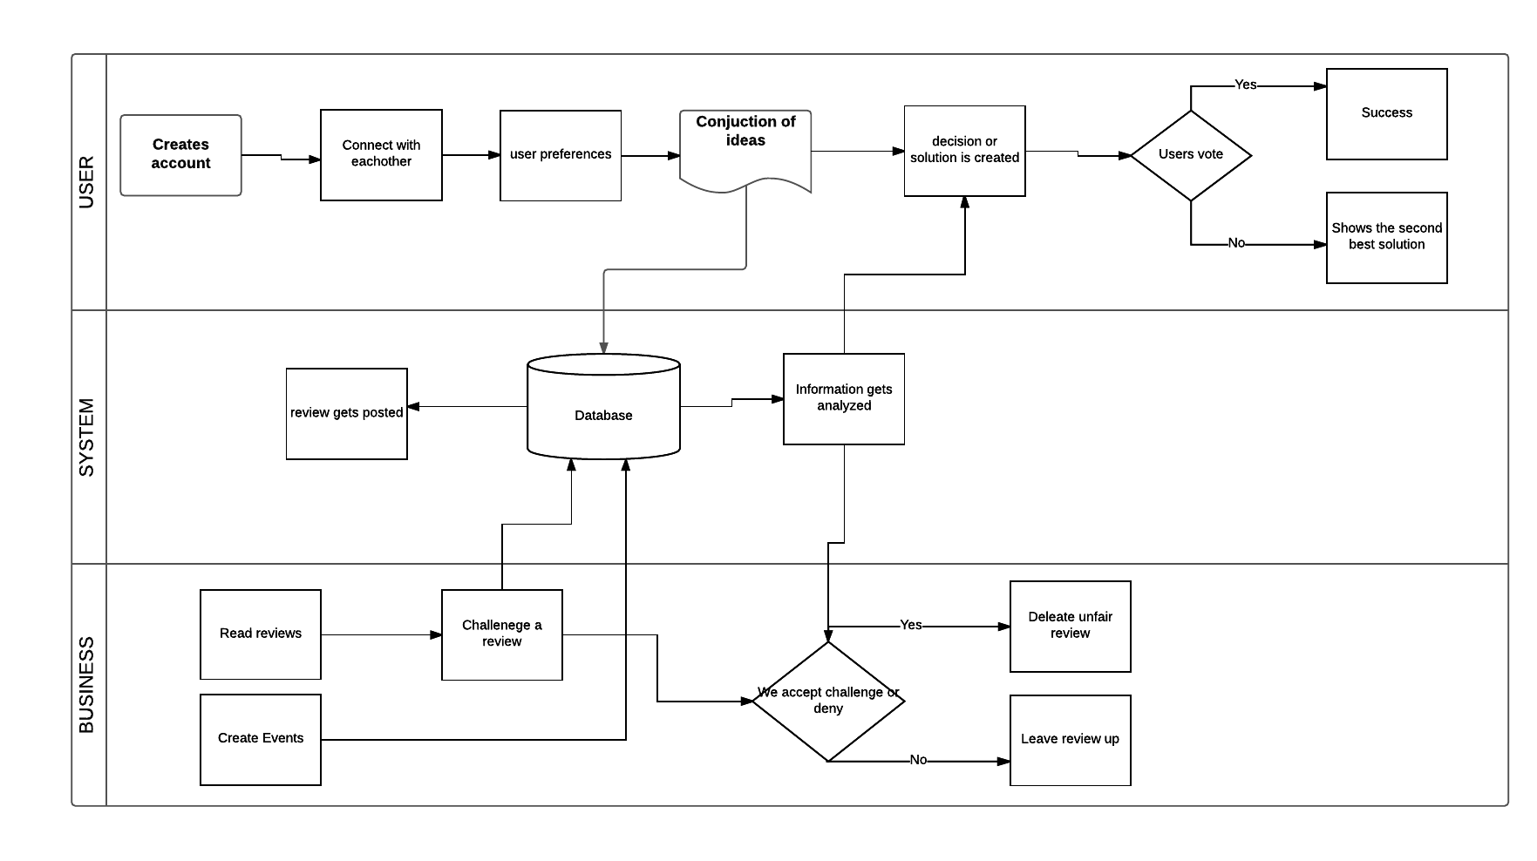
BPMN
Notes:
User: makes an account than is able to connect with other people and formulate a list of ideas which our app can than create a possible solution or choice of action for them. They will be able to vote and input their personalities so that our application will be able to display factual information to support its decision.

Slide 5
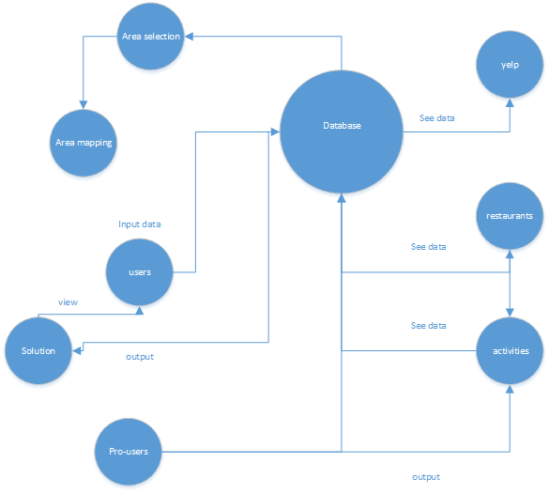
Notes:
Our application takes information from yelp and to give an appropriate suggestion to users about restaurants. Restaurants are able to check reviews left by users of our app and they can make changes to make their businesses better or challenge a review they deem incorrect or false. Activities are special events that restaurants and pro-users are able to create that our application will promote and suggest to users. Users input data into the database through the list of choices they wish to make and the different personalities they have. With a real time map our database will be able to update and show users visually where their event is taking place and how long it will take to get there.

Slide 6
Notes:
They’re business and experiences and users. Our Group of users will have a leader of the group and than it branches out into the each user and their business they are connected to. The businesses have employees who are also users and they will connect with finding other businesses and users. There are two parts to the diagram, business/experience and users of the application. The first part will be organized with businesses being connected as users that set up and create events. The second part will be users lead by a main group leader or creator that connect to each other and give input and recommendations for each “night out” or plan being made. These users can also be connected to businesses through past history and recommendations as well.

Slide 7
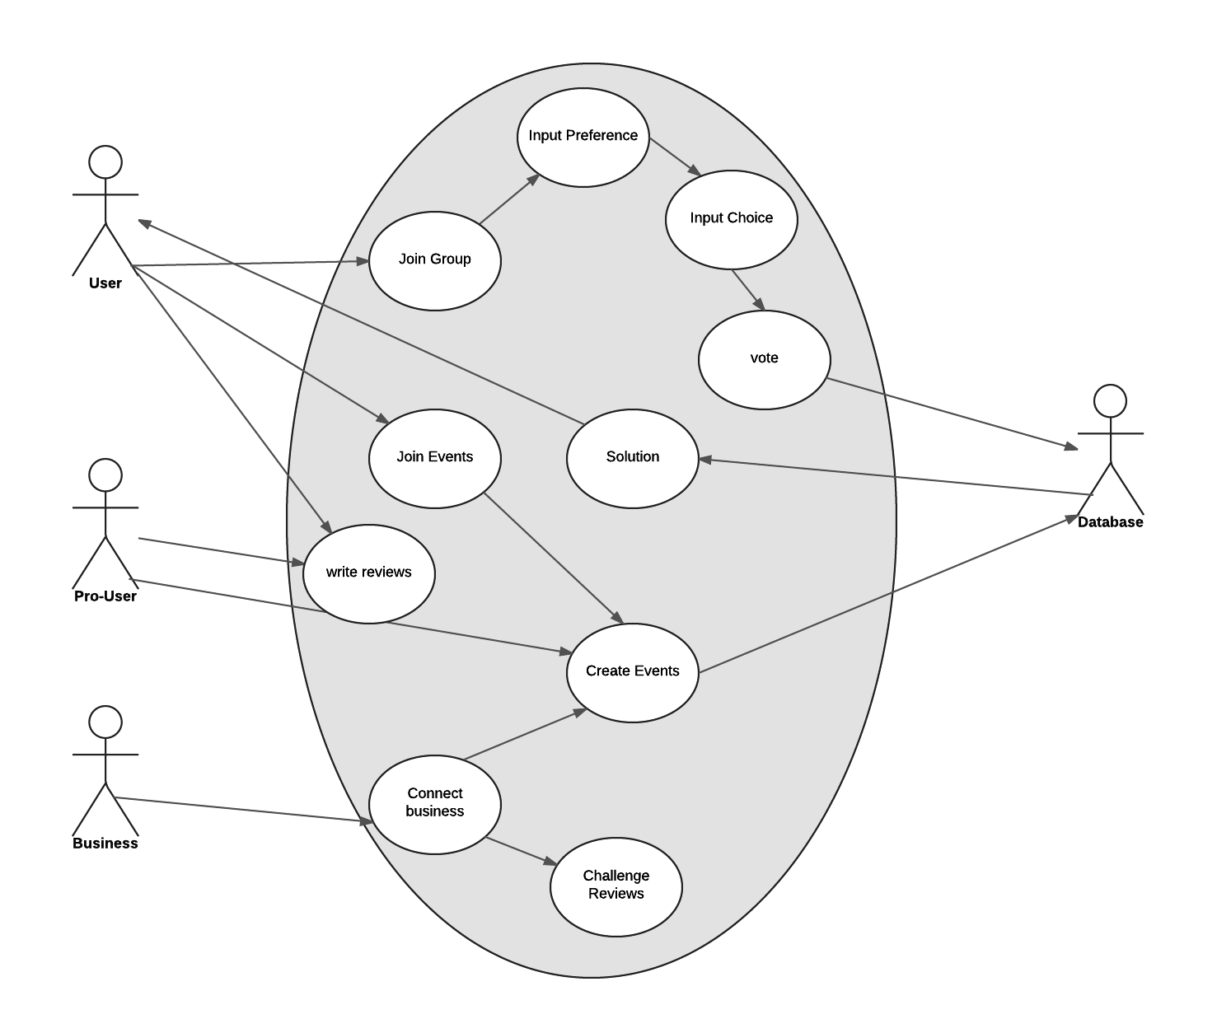
Notes:
Use Case – The Use Case diagram allows a business to show the different interactions between characters and different parts of the uses the application or software does. It’s a most simplistic version of the bpmn. But it gets the point across as it shows our user With his/her different interactions with the application. It also shows the connection between the pro-user and the business as they as important entities in our business.

Slide 8
UML
Notes:
UML Class Diagram – Our UML class diagram allows us to start thinking about different classes that we need to create when we start developing for application. This is extremely useful as it allows us to really communicate with the developers of the application. There are always misunderstandings between the business side of a project and the development side of the project. This really gets across the objects and classes that need to be implemented into the project. It also allows the project team to located different classes that need to be addressed or might have been forgotten about in the creative process.

Slide 9
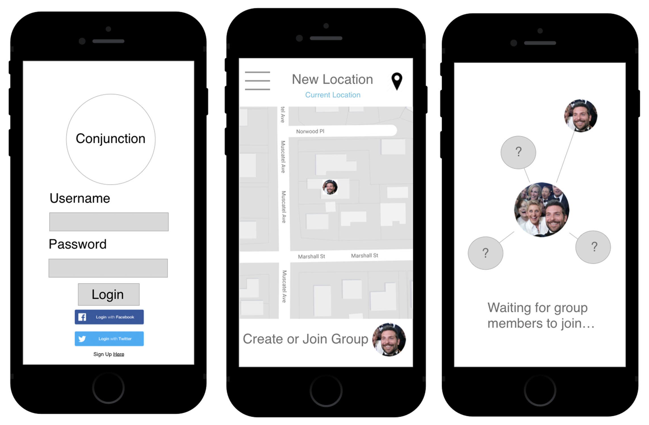
Notes:
Our user will login to our application and than join his or her group.

Slide 10
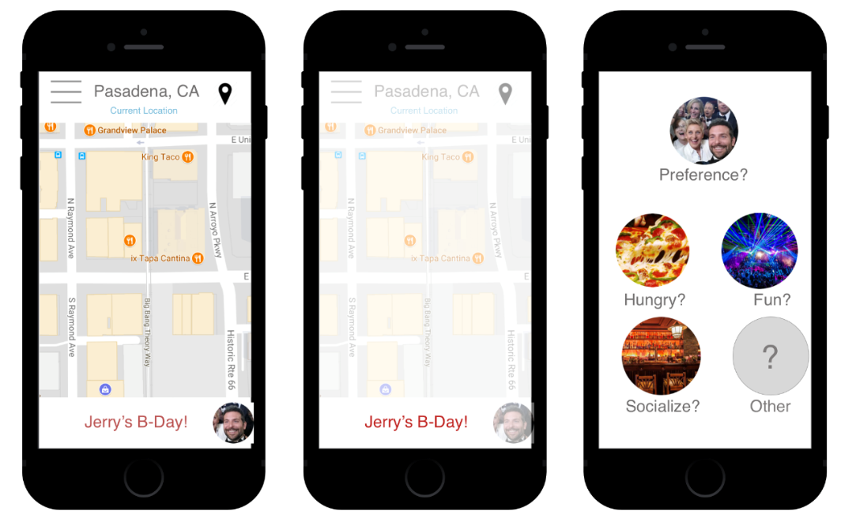
Notes:
Next they will input their preferences and choices into the application.

Slide 11
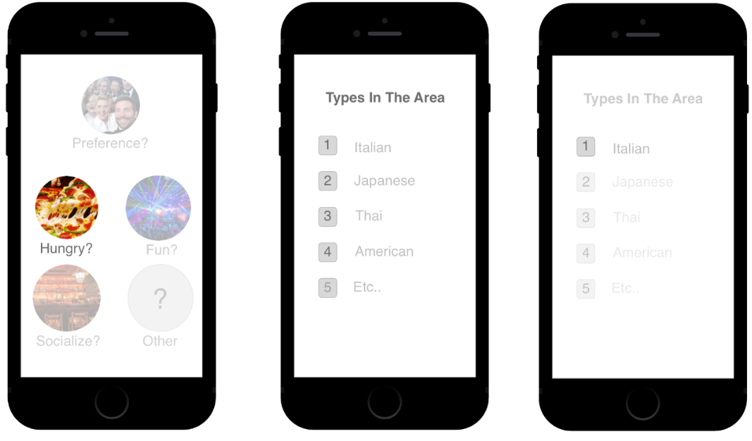
Notes:
Members will make choices about what they would like to do.

Slide 12
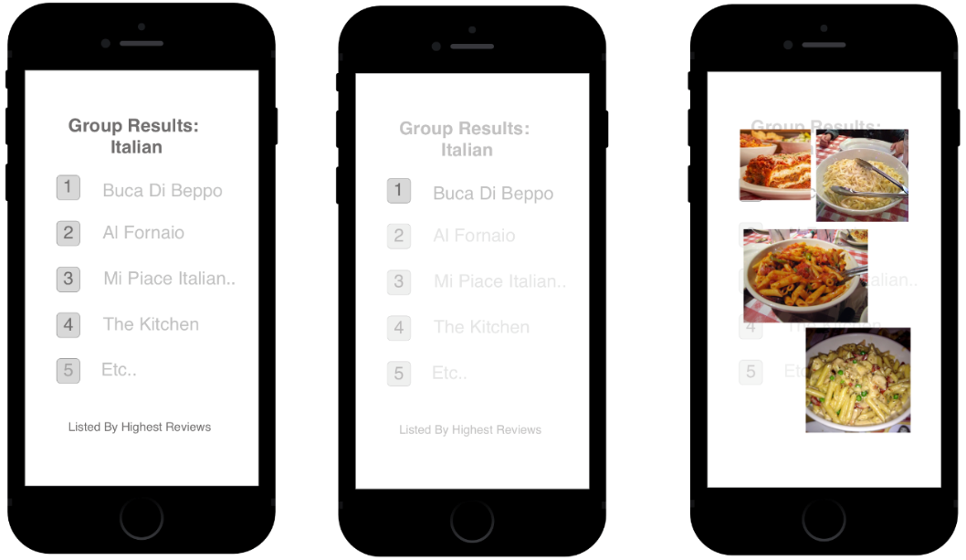
Notes:
Once they vote our application will give them a recommendation of what they should do.

Slide 13
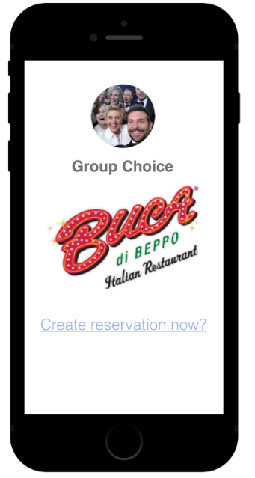
Notes:
This page allows our user to make a reservation at an event.

Slide 14
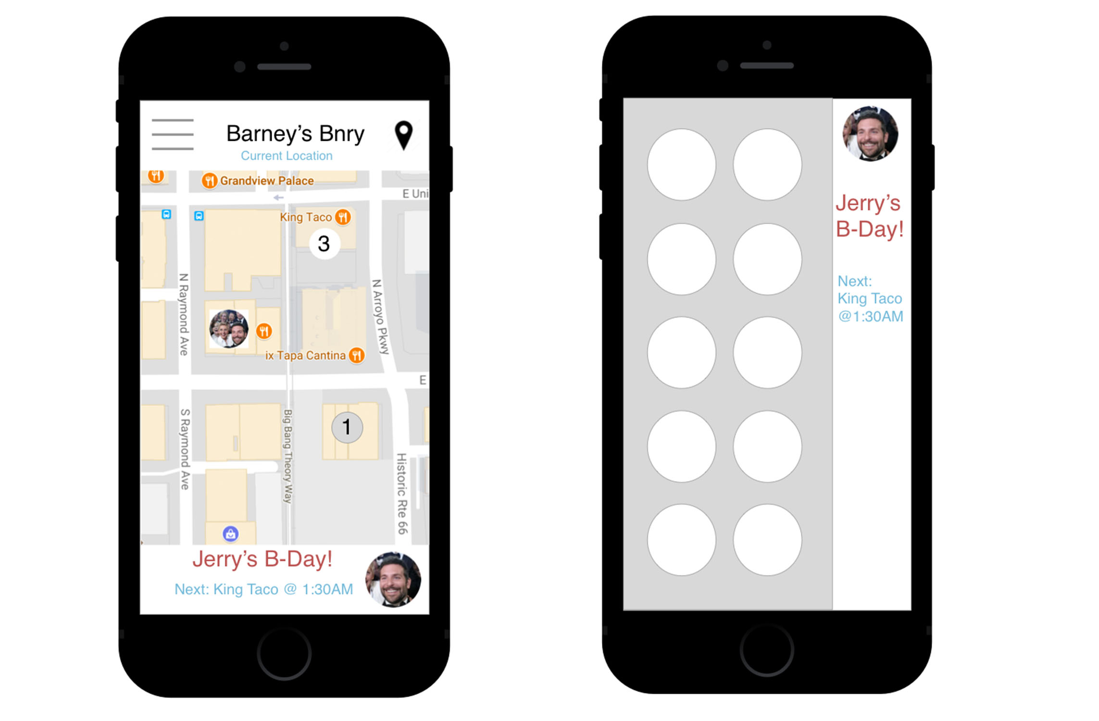
Notes:
This shows the group at a location and them going to their first location.

Slide 15
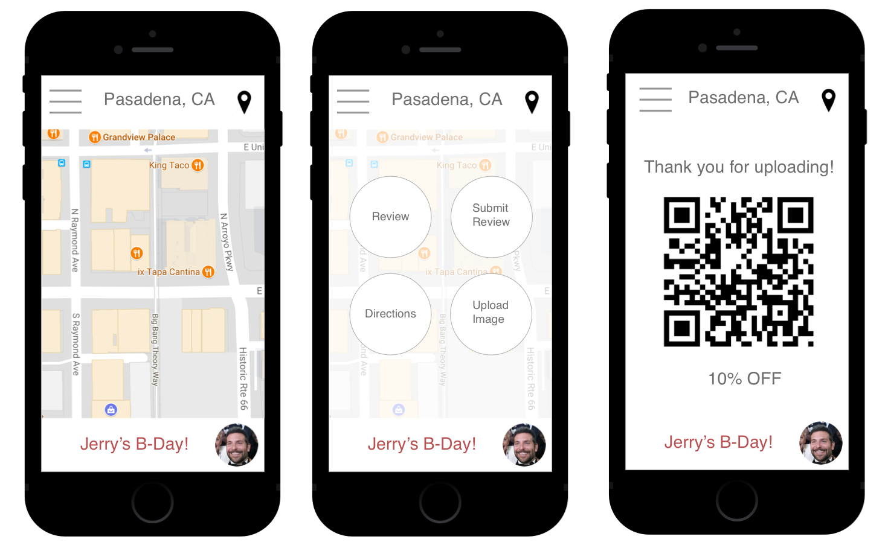
Notes:
These pages allows our user to review different institutions and get rewarded for making a review.

Slide 16
Notes:
ERD – This Erd shows how the structure of our database will be created. We have our user which has a relationship with CHOICE, RECOMMENDATION, PROUSER, and REVIEW. Our business and Events are connected to our user by the REVIEW table. Our REVIEW table has a many to one relationship with our USER, BUSINESS, and EVENT tables.

Slide 17
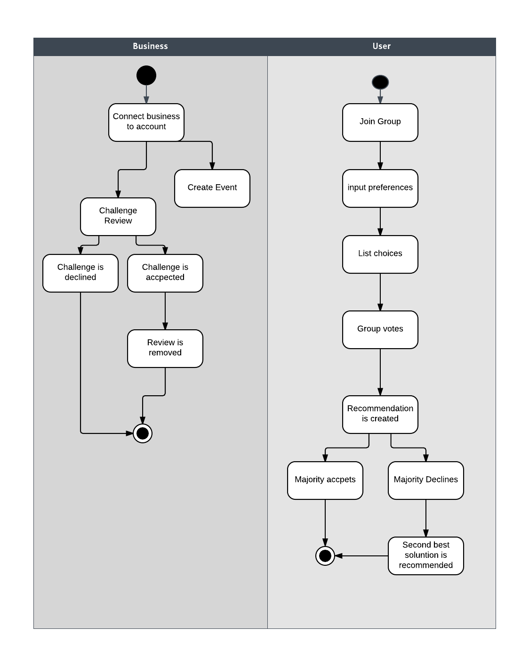
Activity Diagram
Notes:
Activity Diagram – The activity diagram allows us to visually show the different actions our application has pertaining to the different users. For our business users they will create an account and have the choice to do two things. They can either create an event or challenge a review. Once they challenge a review our application will either approve or deny the action. If it is denied than they are done if accepted than we will remove the review. Next, the user will create an account and they can join a group. Once in the group they will input their preferences and list their choices. After, they will vote as a group on what they want to do. Once the votes are in the application will populated an answer or recommendation to the group and what thye should do.

Slide 18
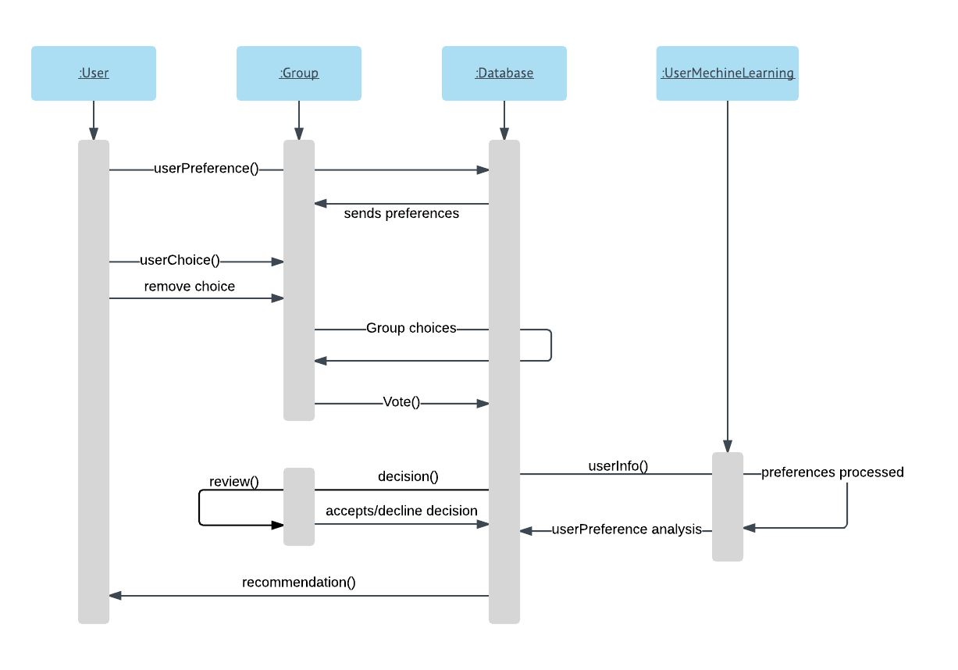
Sequence Diagram
Notes:
Sequence diagram – Sequence diagram allows us to see our application in terms of the connection between the different entities we have. First is the user and its relationship with other entities. The user connects to the database and than joins a group. Once in a group with other users they will send in their preferences and choices so that the other group members can see and the database will also take this information in to make smarter suggestions to our users. Once everyone in the group has made their choices, they vote on what they would like to do. Lastly our application will use information the users in the group have inputted and information it gathers through other means such as the database and make a recomendation.

Slide 19
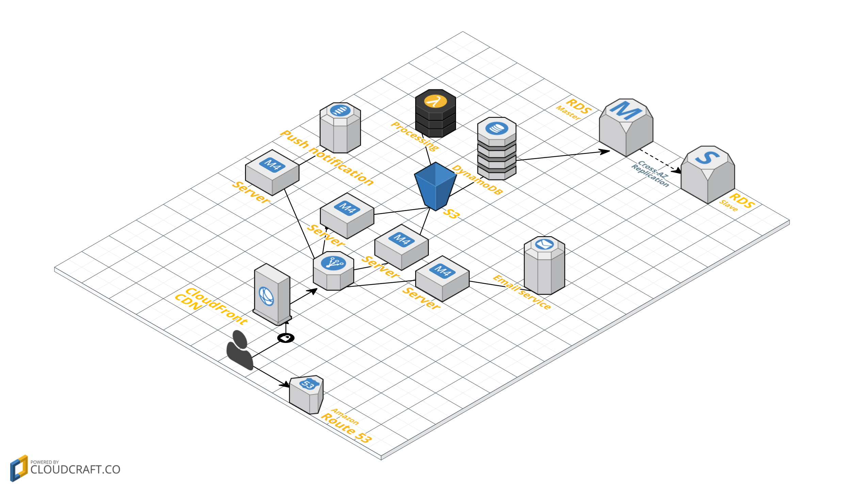
Notes:
This diagram shows the structure of our business. We have our users who connect to the cloud front and than they get sent to the nearest server that we have. We have a server dedicated to sending notifications of special events to our users and one specifically for our email server. Since our application is user driven it is extreamly important for us to have a way to communicated directly with our users with problems and our Por-users who would like to create events.

Slide 20
Notes:
PESLTE Diagram – PESTLE allows us as an organization view the political, economic, sociological, legal, technical, and environmental forces that may affect our business in the future. By identifying these issues, it allows us to really understand external factors which we as a business must acknowledge in order to be successful. For political factors, we have new tax policy, government stability and political climate. Depending on the government and political stability of the United States our primary market, our app will flourish do to it ability to populated events and allow local communities to communicate with each other. Economic factors include value of currency and how well the market is doing. Depending on peoples income levels they will either have the will to spend or not.

Slide 21
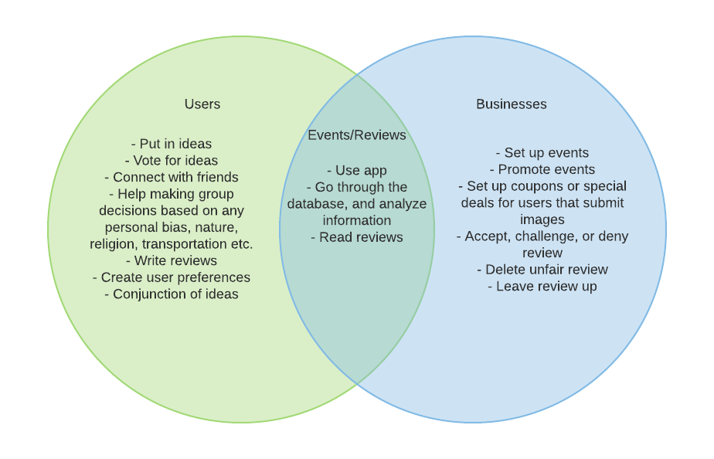
Notes:
We are analyzing our User and Businesses and how to they relate to each other. Users make decisions and group choices while business main job would be to maintain a positive image. But a way to bring our User and Business together would be reviews and events. Events and reviews bring both these entities together.

Slide 22
Notes:
Porters Five Forces – Porters five forces allows us to look at the market in which our application will compete with. This is important that we understand the threat of new entrants and threats of substitution. This is good know as it shows who we need to compete with and by knowing that we can adjust to their strategies and failures. It also allows us to forecast the cost of running our business as the different barriers of entries.

Slide 23
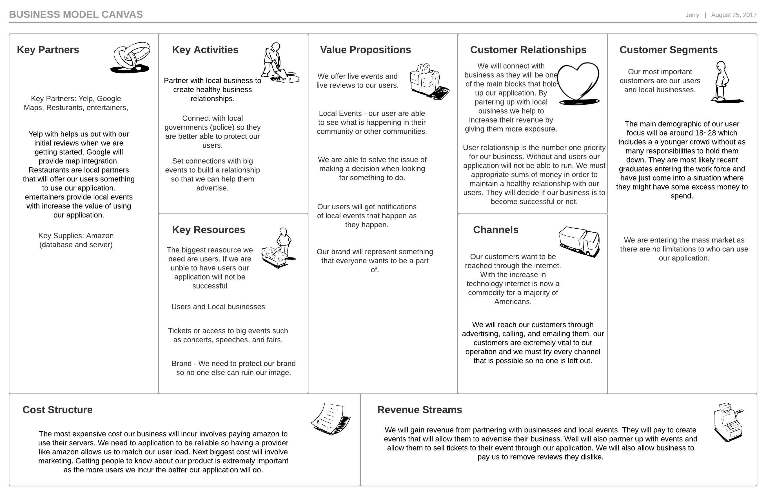
Notes:
Business Model Canvas – The Business Model Canvas allows us to identify how our business will run. We identify Key partners, Key activities, Key resources, Value propositions, Customer Relationships, Channels, Customer Segments, Cost Structure, and Revenue Streams affect our business. Key partners include different entities such as google, yelp. restaurants and our users. Key activities in our business include reaching out to users and businesses to use our application. We also need to partner with local government to make sure our users are safe when using our application. Some Key resources we have include our users, brand, server/database, and access to events in the form of tickets. Our value propositions include give live and local events to our users. Customer relationship is a top priority and will be a big part of our process because they are the determinant of the success of our application.

Slide 24
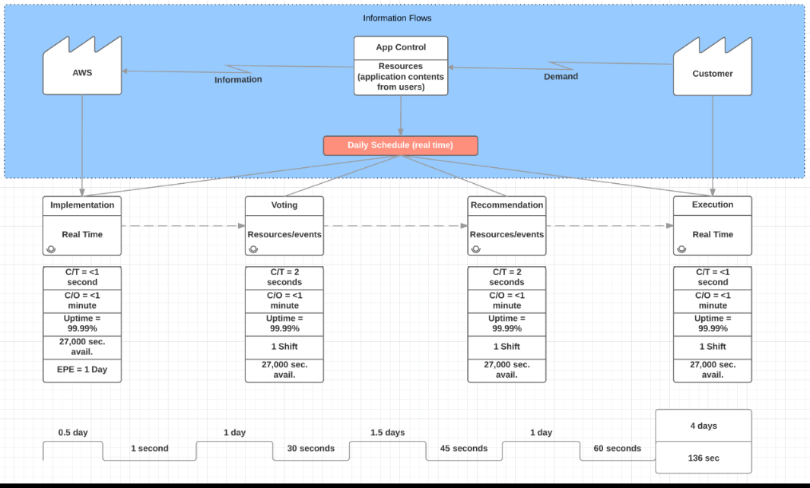
Notes:
Value stream analysis : this diagram will allow us to manage how our application utilizes resources. We need to be able to take in user information and request and put out recommendation and local events that users are looking for. We need to understand the speed which the process flows to understand how we as a business work and how to maximize our operations.

